Slide 1

Smart Meter Data
The Pot of Gold Under The Virtual Rainbow
Andrew Klinkman
Jake Reeder
Josh Seidenfeld
Louis Winkler
Energy 590 | January 21, 2015

Slide 2
Agenda
Purpose
Data
Pilot Implementation
Surveys
Challenges
Literature
2

Slide 3
Smart Metering Project Purpose
Initiated in 2007 to assess performance of Smart Meters, their impact on consumers’ energy consumption, and the economic case for a wider rollout.
Collaborative energy industry-wide project managed by the CER and actively involving a host of energy industry participants.
Smart Metering Electricity Customer Behavior Trials (CBTs) took place during 2009 and 2010 with over 5,000 Irish homes and businesses participating.
Smart Metering Gas Customer Behavior Trials (CBTs) took place during 2010 and 2011 with nearly 2,000 Irish homes participating.
3

Slide 4
Trials’ Purpose
Research how smart metering can help shape energy usage behaviors across a variety of demographics, lifestyles and home sizes.
Assess the impact on consumer’s electricity and gas consumption in order to inform the cost-benefit analysis for a national smart meter rollout.
Establish anonymous, detailed data underlying the electricity customer behavior trial results to facilitate further research and the development of competitive products and services following the anticipated rollout of Smart Meters in Ireland.
4

Slide 5
Agenda
Purpose
Data
Pilot Implementation
Surveys
Challenges
Literature
5

Slide 6
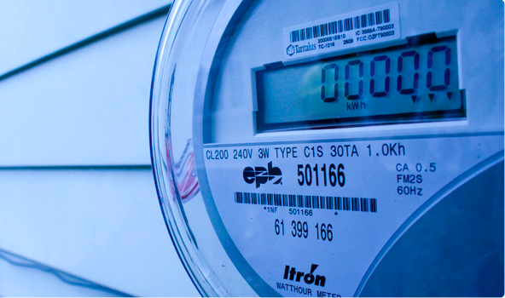
What Data Was Collected?
For every meter participating from July 2009-December 2010:
Meter Reading every half hour
Time of Use of Tariff (4 types)
DSM Structure implemented (4 types)
Pre and Post Trial Survey Answers
Business or Residential
6

Slide 7
Agenda
Purpose
Data
Pilot Implementation
Surveys
Challenges
Literature
7

Slide 8
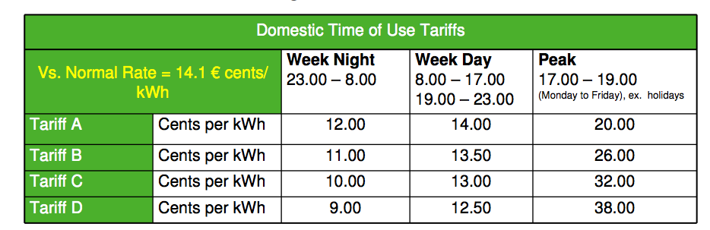
Implementation
The Commission for Energy Reform recruited over 5000 Irish homes and over 650 businesses on a volunteer basis through a mailed letter.
Two main variables: time of use pricing and additional informational on usage
Additional information on usage:
All volunteers had a smart meter installed in their home, along with a monitor that displayed the price of electricity in a real-time basis as well as stickers and fridge magnets to help prompt compliance
Volunteers also received monthly or bimonthly energy usage statements with their billing
Time of Use Pricing
Electricity tariffs were set a different levels for three time periods: week nights, week days, and peak:
8

Slide 9
Agenda
Purpose
Data
Pilot Implementation
Surveys
Challenges
Literature
9

Slide 10
Surveys
Surveys conducted in addition to raw data on usage
Four surveys: pre and post trial for SMEs and housholds
Pre: Questions focused on attitudes and usage.
Post: Many attitudinal questions (e.g., "I do not want to be told how much electricity I use")
Questions about appliances and usage
Questions about interaction with the trial
Similar questions for businesses
10

Slide 11
Agenda
Purpose
Data
Pilot Implementation
Surveys
Challenges
Literature
11

Slide 12
Challenges: Implementation
Link between peak and bill reductions
Customers may have exaggerated expectations of savings/penalties from peak activities
Potential Selection Bias
Customers who participated may have been more motivated to reduce usage
No way to isolate individual DSM technique effects
TOU Rates must be designed to be cost-neutral with no behavior change
12

Slide 13
Challenges: Analysis
Multiple Treatment Groups
4 Tariffs, 4 Demand Side Management techniques
Missing Meter Data
Projections to wider population
Used bootstrapping techniques to simulate data
Tipping point exploration
Inclusion of attitudinal analysis
Surveys measured consumer engagement and interest in energy savings
13

Slide 14
Agenda
Purpose
Data
Pilot Implementation
Surveys
Challenges
Literature
14

Slide 15
Literature
Commission for Energy Regulation (2011), “Electricity Smart Metering Customer Behaviour Trials (CBT) Findings Report”. http://www.cer.ie/docs/000340/cer11080(a)(i).pdf
Gans, Will, Anna Alberini, and Alberto Longo. "Smart meter devices and the effect of feedback on residential electricity consumption: Evidence from a natural experiment in Northern Ireland." Energy Economics 36 (2013): 729-743.
Beckel, Christian, et al. "Revealing household characteristics from smart meter data." Energy 78 (2014): 397-410.
15

